Slide 1
Glaucoma Disease Prediction
Supervised binary classification • Patient-record dataset
Problem & objective
Dataset at a glance
Predict whether a patient record is classified as Glaucoma or No Glaucoma using patient information. The project studies machine learning for disease prediction.
1,500 records
Input features: patient details, excluding Patient_ID and Diagnosis.
Target variable: Diagnosis.
Classes: Glaucoma / No Glaucoma.
Methodology
Algorithms compared
Dataset collection → preprocessing → feature selection and encoding → 80:20 train-test split → model training → prediction → performance evaluation.
Random Forest: combines multiple decision trees.
Decision Tree: uses decision rules to classify patient records.
LEARNING TYPE
TASK
BEST REPORTED MODEL
Supervised
Binary classification
Random Forest
Uses Diagnosis as target
Two diagnosis classes
52.00% accuracy
Dataset note: the project file identifies this as a patient-record dataset. If using the synthetic 1,500-record dataset, clearly disclose that it is synthetic.

Slide 2
Glaucoma Prediction | Model Comparison
Performance on the 80:20 train-test split
Classifier | Accuracy | Precision | Recall | F1-score
Random Forest | 52.00% | 53.09% | 55.84% | 54.43%
Decision Tree | 50.00% | 51.27% | 52.60% | 51.92%
BEST CLASSIFIER
ACCURACY
DATA SPLIT
Random Forest
52.00%
1,200 / 300
Higher reported accuracy
Needs improvement
Training / testing records
Interpretation: Random Forest is only slightly higher than Decision Tree (52% vs 50%). These results are weak and should not be presented as clinically reliable disease detection.

Slide 3
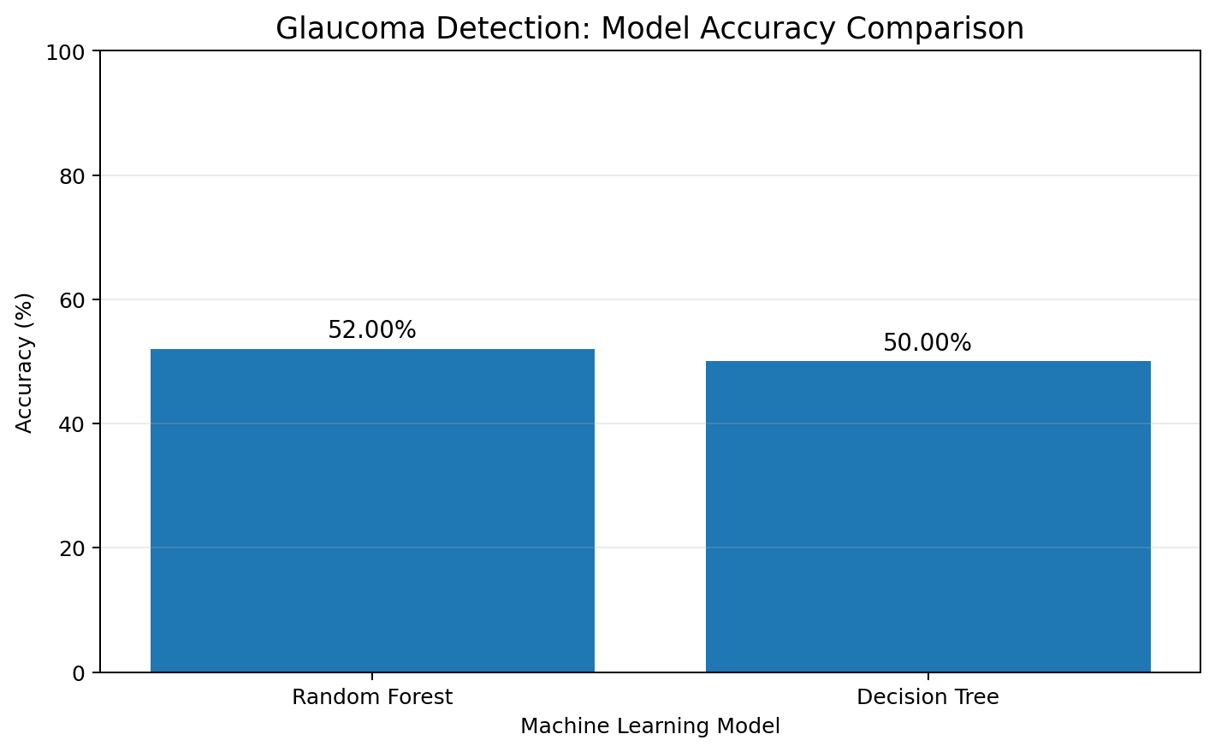
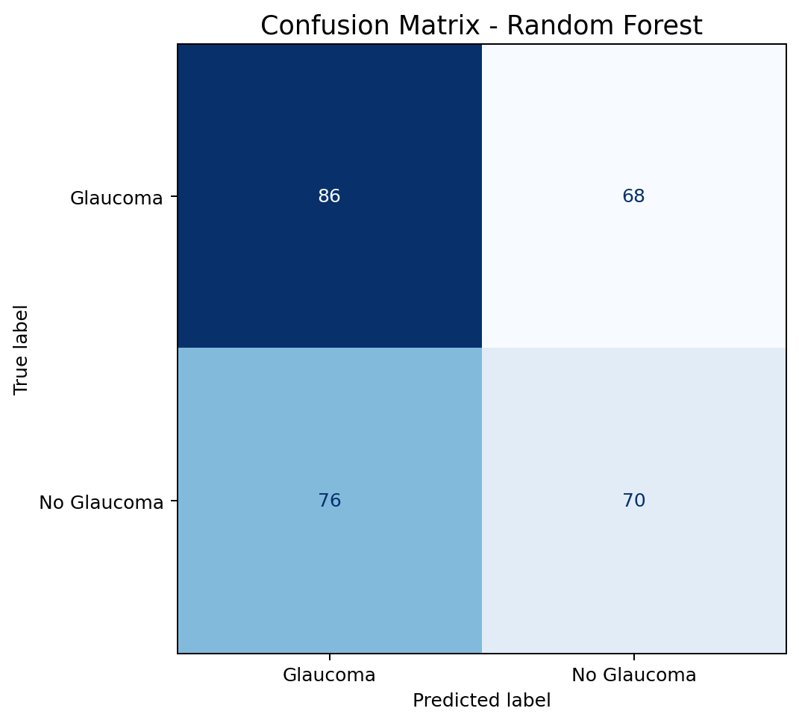
Glaucoma Prediction | Evaluation & Conclusion
Accuracy comparison and confusion matrix for Random Forest
Accuracy comparison
Confusion matrix – Random Forest
Metrics used: accuracy, precision, recall, F1-score and confusion matrix. Random Forest achieved 52% accuracy versus 50% for Decision Tree. The model needs improvement and validation using real medical data before any practical or clinical use.

